Slide 1

SOAR: Fundamentals Augmentation
Matthew R. Versaggi
Sr. Dir of AI, ML, and CT for the ATC
Distinguished Engineer

Slide 2

Why consider Cognitive Technology?
The Value Proposition
The Human mind is a general purpose problem solving structure – it is able to learn many, many subjects and solve problems in all of them using one single structure.
Unlike Conventional AI (that only handle narrowly defined problems), Cognitive Technology provides a general problem solving capability not found in other forms of narrow AI.
This provides the promise of solving a large set of healthcare related problems that have been resistant to other narrow AI approaches - it does this because CT can model human cognition.
This is referred to as “Computational Cognition” – and is based in Cognitive Sciences.
Key Attributes of Cognition
Attention
Knowledge
Memory
Judgment
Reasoning
Problem Solving
Decision Making
Comprehension
Language
Learning

Slide 3
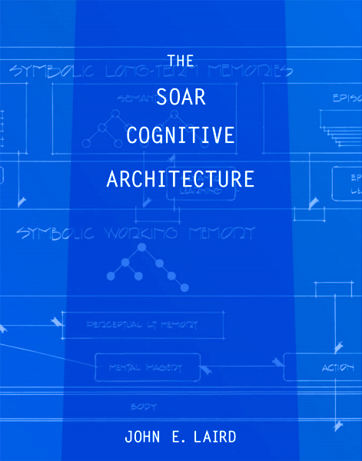
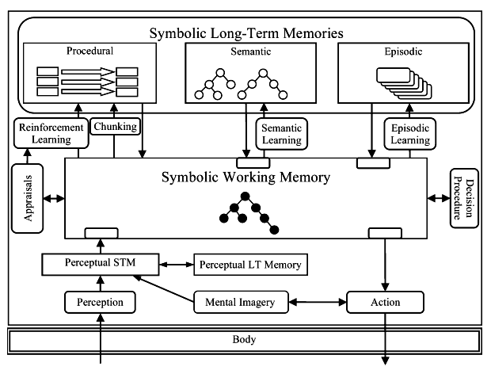
Example of a mature "Cognitive Architecture”: SOAR.
State, Operator, And Result.
SOAR strives toward human-level intelligence inspired by psychology and biology, and emphasizes more complex cognitive processing.
Notes:
Example of a mature "Cognitive Architecture" : SOAR
Soar’s name is derived from this basic cycle of State, Operator, And Result; however, it is no longer regarded as an acronym.
The SOAR Cognitive Architecture is 35 years mature, originated at CMU AI program, and moved to U of Michigan where it is actively developed today. It's also been spun off into a military contractor business providing AI/CT to DARPA and the Navy called "SOAR Tech".
The SOAR Cognitive Architecture should be thought of as implementation of a of human cognition hypothesis - the Problem Space Computational Model (PSCM) that argues complex cognition arises from a fixed set of computational building blocks (memories, processes, representations, learning mechanisms) and knowledge (as learned through experience).
SOAR strives toward human-level intelligence inspired by psychology and biology and emphasizes more complex cognitive processing.

Slide 4
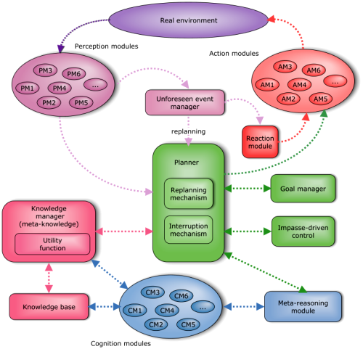
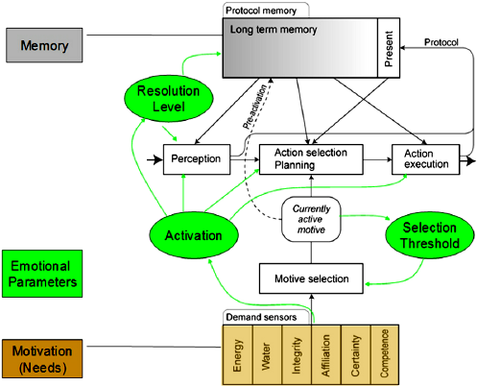
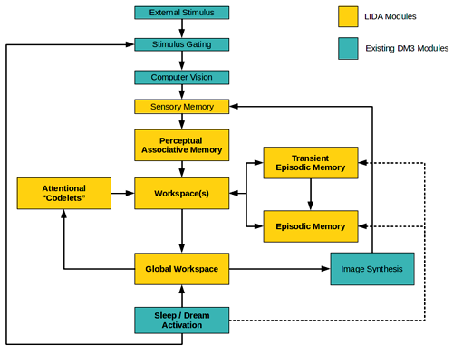
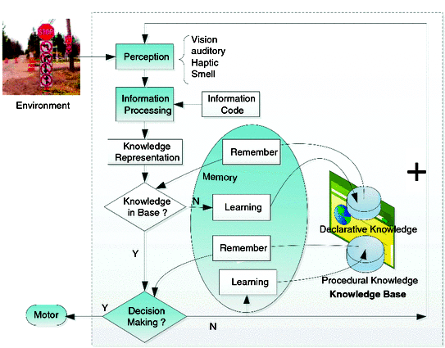
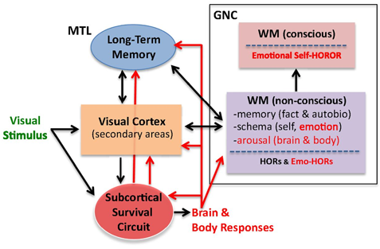
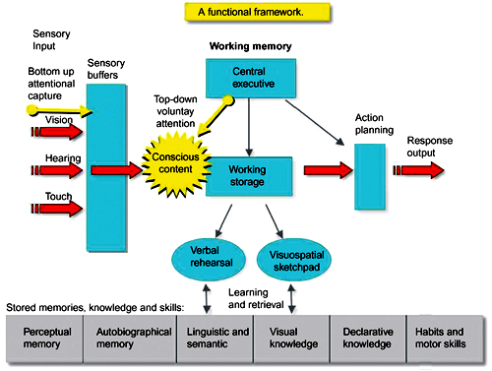
Q: What is a Cognitive Architecture?
SOAR, EPIC, ACT-R, ICARUS, ADAPT, AAR
A: It’s a Hypothesis of Human Cognition – in a software system.
Notes:
What is a Cognitive Architecture?
Cognitive architecture is the theory about the structures of the human mind and how they work together to manage intelligent behavior in any complex environment.
A goal of cognitive architecture is to use the research of cognitive psychology to create a complete computer model of cognition.
Successful cognitive architecture models include:
Active Control of Thought-Rational (ACT-R) was developed at Carnegie Mellon University by John Robert Anderson. ACT-R attempts to study how the brain organizes itself into singular processing modules to reduce cognitive functions to the most basic operations that can enable cognition.
Learning Intelligent Distribution Agent (LIDA) was created by Stan Franklin and colleagues at the University of Memphis. The architecture was created as an integrated model that attempts to broadly model human cognition, from perception and action to high-level reasoning.
SOAR was developed by John Laird, Allen Newell and Paul Rosenbloom at Carnegie Mellon University and drew from ACT-R and LIDA. The model's objective was to develop generalized intelligent agents for a range of tasks that also functioned as the building blocks to emulate human cognitive capacity.

Slide 5
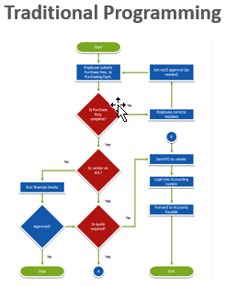
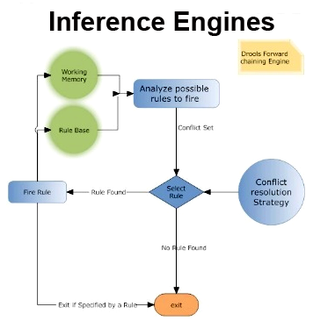
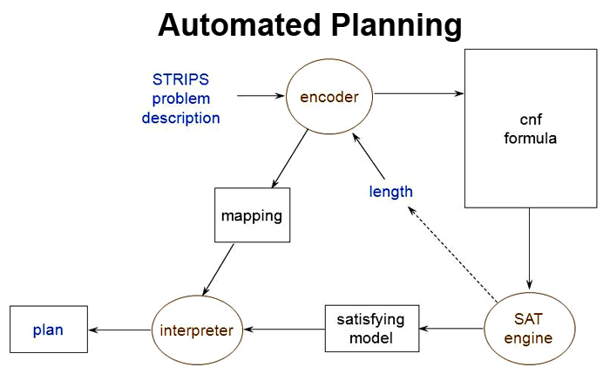
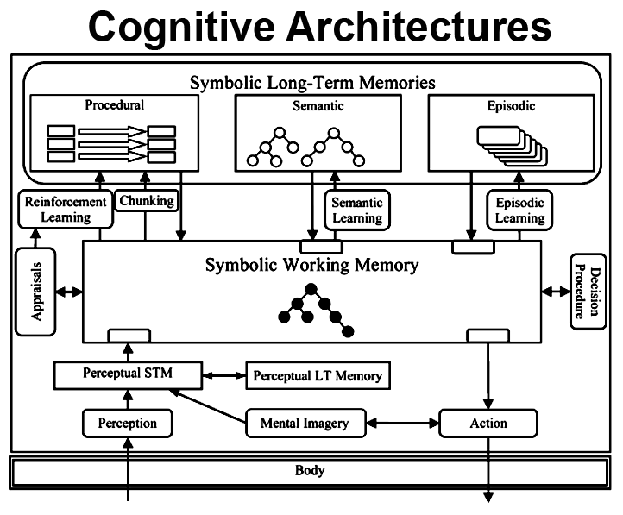
Programming vs Engines vs Cognitive Architectures ( Highlighting the differences )
General Purpose
Compiled or Interpreted
Create anything: games => UI’s
Java, Python, C++, Basic, Pascal
Not General Purpose – FC / BC IE
Write code for the Engine only
Create new inferences for a specific “use-case space” only
Leverages single purpose algorithm : RETE, Unification / backtracking
FC: Drools, FlexRule, AWS Rules
BC: Prolog, Knowledge Machine, ECLiPSe
Not General Purpose - Automated Planner
Write code for the Planning Engine only
Use-Case specific solutions only
Leverages Situational Calculus, PDDL & Planning Graphs
STRIPS, SATPLAN
Not General Purpose - Cognitive Architecture
Write for a multitude of integrated subsystems:
Reasoning
Perception
Knowledge Representation
Planning (Automated)
Problem Solving
Memory
Learning
Input / output
Decision Making
SOAR, EPIC, ACT-R, ICARUS, ADAPT, AAR
Notes:
How Cognitive Architectures differ from classical programming/development?
Inference engine
In the field of Artificial Intelligence, inference engine is a component of the system that applies logical rules to the knowledge base to deduce new information. The first inference engines were components of expert systems. The typical expert system consisted of a knowledge base and an inference engine. The knowledge base stored facts about the world. The inference engine applies logical rules to the knowledge base and deduced new knowledge. This process would iterate as each new fact in the knowledge base could trigger additional rules in the inference engine. Inference engines work primarily in one of two modes either special rule or facts: forward chaining and backward chaining. Forward chaining starts with the known facts and asserts new facts. Backward chaining starts with goals, and works backward to determine what facts must be asserted so that the goals can be achieved.
Traditional programming model
Backward Chaining Inference Engine
Forward Chaining Inference Engine
Cognitive Architecture (highly integrated)

Slide 6
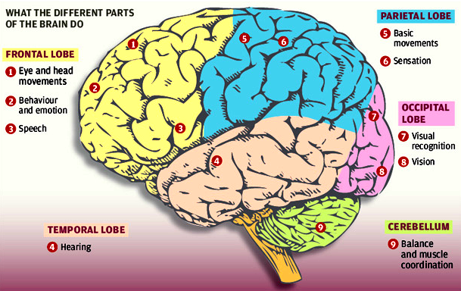
Cognitive Brain Functions
The Brain as a “Structure”:
Highly connected and integrated whole
Discrete segments doing specialized tasks
Diversity of unique capabilities
Whole is greater than the sum of the parts
As a result – ”Real Human Cognition”

Slide 7
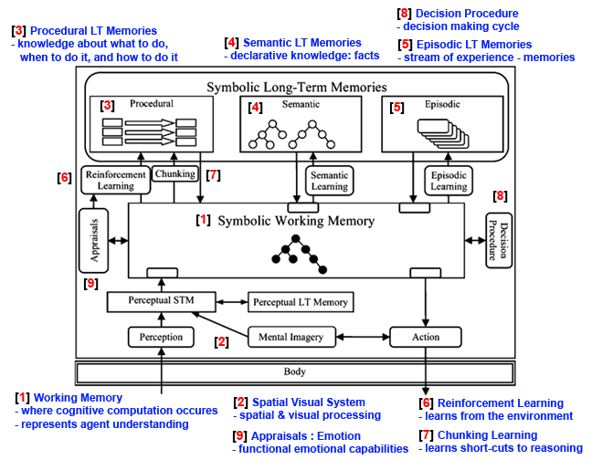
SOAR Cognitive Architecture Functions
Similar “structure” to Brain:
Highly connected and integrated whole
Discrete segments doing specialized tasks
Diversity of unique capabilities
Whole is greater than the sum of the parts
As a result – “Computational Cognition”
Breakout Session => Deep Dive

Slide 8
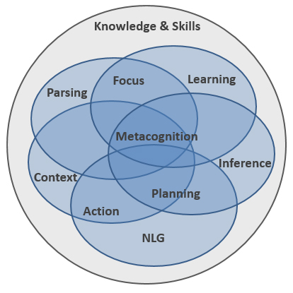
Computational Cognition: Brain Inspired Software Architecture
Highly Integrated
Cognitive Architectures
Definition:- Human Cognition
“The mental action or process of acquiring knowledge and understanding through thought, experience, and the senses.”
Definition:- Cognitive Architecture
Cognitive architecture is a hypothesis inspired by the human mind in which systems work together along with the necessary resources to attain intelligent behavior in any complex environment.
Cognitive architecture's aim is the development of artificial agents that support the same capabilities as that of the human mind.
Cognitive architectures are a lot like computer architectures, except they manipulate knowledge capabilities instead of bits.
Key Aspects:
Attention
Knowledge
Memory
Judgment
Reasoning
Problem Solving
Decision making
Comprehension
Language

Slide 9
Deep Dive: Cognitive Architecture
SOAR Cognitive Architecture
SOAR Cognitive Architecture
Write for a multitude of integrated subsystems:
Reasoning
Perception
Knowledge Representation
Planning (Automated)
Problem Solving
Memory
Learning
Input / output
Decision Making
Etc ….

Slide 10

Deep Dive: SOAR Cognitive Architecture
Decision Making Procedure:
(Deciding what to do next)
Basic decision making processes
Everyday Example – “Cooking”
Goal – Make Dinner
HUMAN Decision Making Process
Account for situation - raw materials, fresh/frozen, timeframe, taste preferences, weekend/weekday, family/guests, casual/formal, bake/broil/stovetop/grill, wine parings, etc.
Consider - all possible dinner options given the information garnered from the above accounting.
Rank - all dinner options based upon “some criteria” – like social entertaining, formal event, avoid allergies, etc.
Make a decision - to prepare a steak dinner, for example.
Do something - Begin the actual process of making a steak dinner.
SOAR Decision Making Process
State Elaborations - take stock of the immediate situation given the context
Operator Proposal - propose all plausible options given the current situation .
Operator Evaluation - evaluate all proposals against each other and the goal.
Operator Decision - the decision to select one proposal is made by the system.
Operator Application – behavior: actually “do” that action which was decided upon.

Slide 11
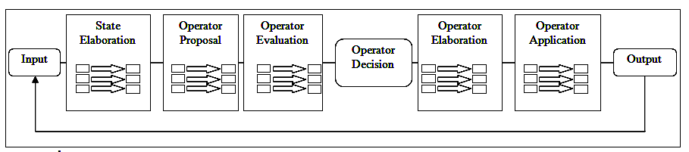
Deep Dive: SOAR Cognitive Architecture
Decision Making Procedure:
(Deciding what to do next)
Basic decision making processes
At an abstract level, the decision cycle consists of four phases:
Input,
Decision Selection,
Decision Application,
Output.
Elaborations are a reasoning process that helps make a decision or perform an action.
Behavior arises from a series of decisions – the continuous process of deciding what to do next.
Input
Decision Selection
Decision Application
Output
State Elaborations – take stock of the immediate situation given the context
Example: Making Dinner – (Accounting for: raw materials, fresh/frozen, timeframe, taste preferences, weekend/weekday, family/guests, casual/formal, bake/broil/stovetop/grill)
Operator Proposal – propose all plausible options given the current situation
Example: Making Dinner – (Consider all viable dinner options/choices: given the information garnered from the above actions and elsewhere)
Operator Evaluation – evaluate all proposals against each other and the goal
Example: Making Dinner – (Rank all dinner proposals based upon some criteria – like social entertaining)
Operator Decision – the decision to select one proposal is made by the systems stock internal method (invisible to the developer)
Example: Making Dinner – (Decide to prepare a steak dinner)
Operator Elaborations – take stock of the situation after a decision has been made
Of minimal importance practically – will ignore for now.
Operator Application – actually “do” that action which was decided upon
Example: Making Dinner – (Begin the process of making a steak dinner)

Slide 12

Deep Dive: SOAR Cognitive Architecture
Working Memory:
(How agents "think" and "behave")
Dinner Example
THEORY
Working memory is a foundational / theoretical concept central to cognitive science - defined as the ability to maintain and manipulate information over short periods of time.
Working memory is important for reasoning, and the guidance of decision-making and behavior; facilitates planning, comprehension, and problem-solving.
Example(s):
When we try to remember a recipe before writing it down.
When we do mental calculations to see if we have enough raw ingredients to complete a menu.
When we take notes at cooking school: we need to remember what the instructor said so that we can write it down in our own words.
When we do mental math in the supermarket to see if we have enough money to pay.

Slide 13
Deep Dive: SOAR Cognitive Architecture
Impasses and Substates :
(When one “can't decide” what to do)
THEORY
Human-level agents often encounter novel situations where the knowledge that they can directly recall is incomplete, uncertain, or inconsistent – and they unable to make progress.
The rationale for this approach is straightforward - when knowledge is sufficient to make a decision, complex reasoning isn't necessary.
Complex reasoning is necessary when knowledge is incomplete, conflicting, or uncertain.
Many of the forms of complex reasoning that are possible, including hierarchical task decomposition, planning, perspective taking, and anticipation.
Dinner Example
Example(s):
When we can’t decide on a proper binding agent for those intolerant of eggs - (bananas, avocado, cornstarch, chickpea powder) or to other allergies.
When we can’t decide which wine gets paired properly with each dish or desert.
When we take can’t decide on a menu for a particular formal event: take a “Bar Mitzah”, for example.
When we are forced to cook with only certain ingredients – think “Cut-Throat Kitchen”, for example.

Slide 14
Deep Dive: SOAR Cognitive Architecture
Chunking:- Automated Learning
(Mental “Shortcuts” from experience)
THEORY
Chunking is an automatic mechanism for learning.
When a decision gets made, SOAR determines which processes supported that and then builds mental shortcuts to speed up processing later – thus the system “learns” from doing.
The technical term is called “Generalizing Justifications”.
The efficiencies gained from such “shortcut processing” are often exponential speedups in the reasoning required to solve similar problems.
Dinner Example
Example(s):
After we first lean how to cook a whole turkey, we then are able cook a whole chicken faster.
After we first lean how to season stew properly, we then are able to season soups faster.
After the first year of culinary work, we rarely need to measure ingredients any more – think “Grandma’s Kitchen”.
After we first learn how to grill steak, we then are able to grill chicken faster.

Slide 15
Deep Dive: SOAR Cognitive Architecture
Reinforcement Learning:
(Learning from “interacting w/environment”)
Dinner Example
THEORY
Reinforcement Learning is a automatic learning mechanisms that use (+/-) rewards as a source of knowledge about performance.
Using experience, reinforcement learning algorithms adjust the agent’s expectations of future rewards for its actions in different situations. These stored expectations are then used to select actions that maximize expected future reward.
Example(s):
The first time we purchase substandard ingredients and the result isn’t stellar, we learn not to do that anymore.
The first time we cut our finger by slicing improperly and it hurts, we learn not to do that anymore.
The first time we pair up wine and dinner properly and the results are fantastic, we learn to repeat that more.
The first time we first learn how to do a proper cross sear onto steak and people love it, then we learn to repeat that more.

Slide 16
Deep Dive: SOAR Cognitive Architecture
Semantic Memory:
(Learning “facts” about the world)
Dinner Example
THEORY
Semantic memory is the conscious, intentional recollection of factual information, previous experiences, and concepts.
Semantic memory is our memory of facts or events that is explicitly stored and retrieved and refers to general world knowledge that we have accumulated over time.
Semantic memory is an efficient means of transferring knowledge from one situation to another.
Example(s):
The “Liter” s a completely different measure than the “Gallon”.
The difference between “well done”, “medium”, “rare” and “blue” for steak.
Wash your hands well after handling chicken.
Salt lowers the boiling temperature of water.
Baking Powder is a mixture of sodium bicarbonate and cream of tartar, and can be used instead of yeast in baking.

Slide 17
Deep Dive: SOAR Cognitive Architecture
Episodic Memory:
(Searching “memories” to decide behavior)
THEORY
Episodic memory represents our memory of experiences and specific events in time in a serial form, from which we can reconstruct the actual events that took place at any given point in our lives.
Episodic memory is an automatic record of a stream of experience. It is what you “ remember, ” and it includes contextualized information about specific events.
Episodic memories make it possible to extract information that may not have been noticed during the original experience and to combine them with current knowledge.
Episodic memory also has a temporal structure that make it possible to retrieve a sequence of episodes that can be used to predict behavior and environmental dynamics in similar situations.
Dinner Example
Example(s):
One can’t decide to boil or fry the eggs – and remembers the guests hate poached eggs, so frying is decided.
When baking in Denver Colorado (Mile High), one can’t decide what temperature to set the oven and remembers that baking over 5000 ft altitude requires an increase in oven temperature by 25 degrees F.
When in a hot chocolate making competition and one can’t decide what would provide an “edge” – and remembers a tiny bit of “capsaicin” (from hot chili peppers) awakens the part of the palate that senses chocolate.

Slide 18
Deep Dive: SOAR Cognitive Architecture
Procedural Memory:
(What to do, When to do it, and How to do it )
Basic behaviors
THEORY
Procedural memory is a part of the long-term memory that is responsible for knowing how to do things, also known as motor skills or second nature skills.
Procedural memory stores information on how to perform certain procedures, such as walking, talking and riding a bike, and does not involve conscious thought.
Procedural memory is a subset of implicit memory, sometimes referred to as unconscious memory or automatic memory. Implicit memory uses past experiences to remember things without thinking about them.
Dinner Example
Example(s):
After a few times boiling water, it becomes second nature.
Once one has peeled a bushel of apples, peeling potatoes is a no-brainer.
After ones first real BBQ, grilling is pretty simple.
After cooking spaghetti once or twice, cooking any pasta requires no thought.

Slide 19
Deep Dive: SOAR Cognitive Architecture
Spatial Visual System:
(An image is worth 1000 words)
Dinner Example
THEORY
Spatial Visual System is provides the capability for making inferences and procuring knowledge from “perception-based representations” (images, shapes, models, 3D Models, etc)
SOAR provides a comprehensive cognitive architecture for spatial and visual processing, and effectively represent and reason about continuous, three dimensional environments.
Example(s):
Does the fish look fresh or old?
Are the salad greens seem like they are wilting or firm?
Does the cake appear to be done?
Does the meringue of the “lemon meringue pie” appear to have stiff peaks?
Are the potatoes look like they are growing roots?

Slide 20
Deep Dive: SOAR Cognitive Architecture
Emotion System (Appraisals):
(Emotional content)
Dinner Example
THEORY
Emotion System (Appraisals) is a hypothesis that “appraisals” provide the data required for abstract functional operations as well as for generating an internal reward signal for reinforcement learning.
Emotion System (Appraisals) distinguish three concepts: emotion, mood, and feeling.
Emotion System (Appraisals) address emotions such as : suddenness, unpredictability, intrinsic pleasantness, relevance, causal and motive, outcome probability, discrepancy from expectation, conduciveness, control and power.
Example(s):
It is no fun cooking for unappreciative picky eaters, avoid that situation.
Chefs do not like running our of raw materials, keep the pantry well stocked.
Cooks love sophisticated appreciative patrons, seek to market to them.
Feeling rushed to get a meal out detracts from the attention to detail of the chef.
Having a famous food critic in the house creates anxiety for the lead chef.

Slide 21
Cognitive Architecture
DEMO: “Eaters !” (Examples of key Computational Cognitive Functions)
(1) Working Memory: (How agents "think" and "behave")
Smarter Agents are "quick witted" (and successful), dumb ones are "dim witted" (and unsuccessful).
(2) Impasses and Substates: (When one “can't decide” what to do)
T ask decomposing (breaking problems down)
Look ahead planning ("thought experiments", evaluate options, choose action)
(3) Chunking: (“Mental Shortcuts”)
Converts "deliberation: (thinking / doing things the hard way) into "reaction" (short cuts)
(4) Reinforcement Learning: (Learning preferences from “interacting w/the environment”)
Positive / Negative external rewards shape future behavior
(5) Semantic Memory: (Learning “facts” about the world)
Efficient means of transferring knowledge from one situation to another (ex: burning your hand)
(6) Episodic Memory: (Searching “memories” to help decide behavior when necessary)
Baseball pitcher example
(7) Procedural Memory: (What to do, When to do it, and How to do it )
Basic behaviors
(7) Decision Making Procedure: (Deciding what to do next)
Basic decision making processes

Slide 22
Deep Dive: SOAR - Demos
Experiential Journey :- Experiment Plan
[1] Initial Experience: “Eaters (PacMan)”
First interaction with SOAR, it’s architecture, and behavior in a fun, easy to digest example – illustrates a wide range of interesting behaviors.

Slide 23
Water Jugs - Reasoning Puzzle
Tutorial – Simple Agents
Simple Decision making.
Example to learn SOAR foundations.

Slide 24
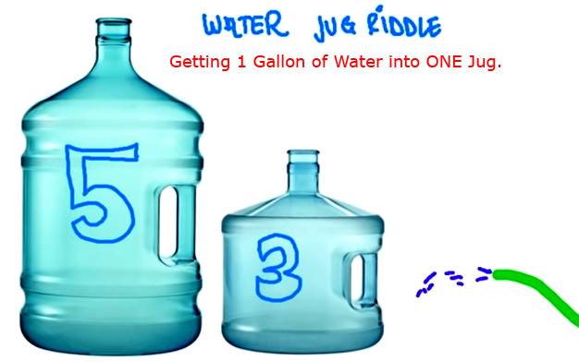
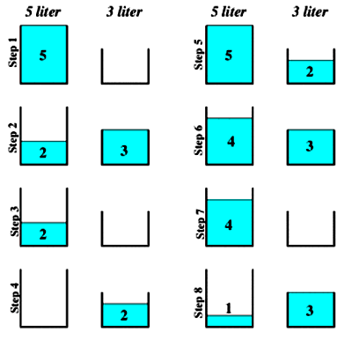
Water Jugs - Reasoning Puzzle
Riddle / Problem to be solved.
Solution Steps - Optimal

Slide 25
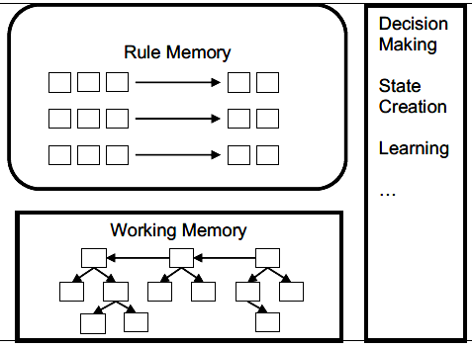
SOAR Underlying Architecture
Component Parts of a Simple SOAR Agent Program
Initialization of the State & Problem Space
Elaborations of the State (Non-persistent changes)
Operators – Proposals and Apply : (Persistent changes)
Search Control over the Problem Space
Monitor State and Operators
Desired State Recognition & Halt

Slide 26
Summary of Problem Formulation in Soar
Below is a summary of the main steps in formulating and representing a problem in Soar.
1. The state representation. These are the attributes and values that are used to describe the different states of the problem.
For this problem the state must represent how much water is in each jug.
2. The initial state creation. An operator will generate the state where the problem solving starts.
In this problem, the initial state has both jugs empty.
3. State elaboration rules. These rules elaborate the state with additional structures that aren’t fundamental to the state (they aren’t created and deleted by operator application rules), but are derived from the core aspect of the state. Thus, they are entailments that are useful abstractions, often making it possible to create simpler rules for proposing and comparing operators.
4. The operator proposal rules. These are the rules that propose the legal state transformations that can be made toward solving the problem. For this problem there are three classes of operators: Fill, Empty, and Pour
a) Pour water from the well into a jug: Fill
b) Pour water from a jug to a jug: Pour
c) Pour water from a jug to the well: Empty
5. The operator application rules. These are the rules that transform the state when an operator is selected.
6. The operator and state monitoring rules. These are optional rules that print out the operator as it applies and prints out the current state.
7. The desired state recognition rule. This is a rule that notices when one of the desired states is achieved.
In this problem, the desired states have one gallon of water in the three-gallon jug.
8. The search control rules. These are optional rules that prefer the selection of one operator over another. Their purpose is to avoid useless operators and/or direct the search toward the desired state. Theoretically you could encode enough rules so that the correct operator is always selected for each state. However, you would have had to already solved the problem yourself to figure out those rules. Our goal is to have the program solve the problem, using only knowledge available from the problem statement and possibly some general knowledge about problem solving. Therefore, search control will be restricted to general problem solving heuristics.

Slide 27

The Importance of Working Memory in Cognitive Systems.
Cognitive Systems are defined by the presence of working memory as fundamental to reasoning capability.

Slide 28
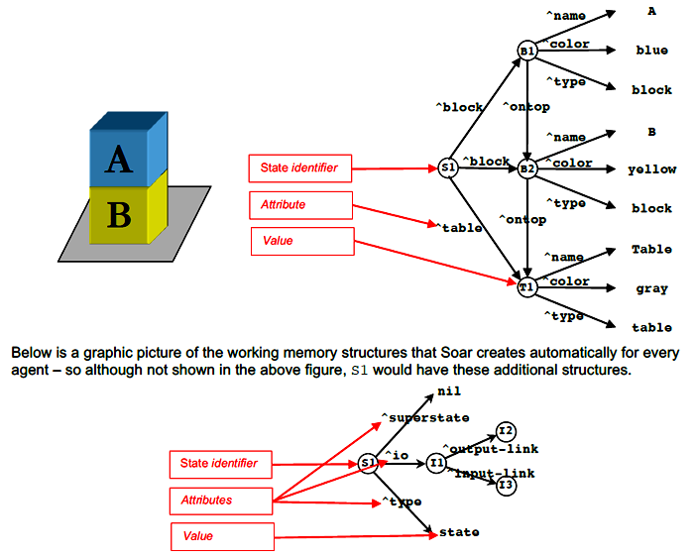
The Importance of Working Memory in Cognitive Systems.
SOAR Working Memory Structure(s)
There are five working META memory elements:
S1 ^superstate nil
S1 ^io I1
S1 ^type state
I1 ^output-link I2
I1 ^input-link I3
SOAR Working Memory Meta Structure(s)

Slide 29
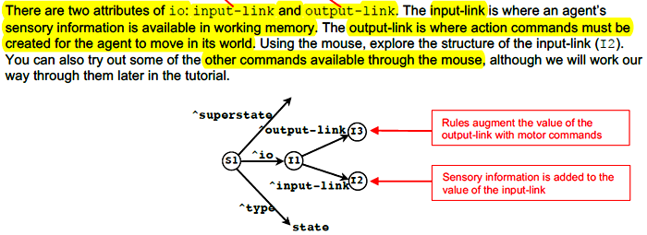
The Importance of Working Memory in Cognitive Systems.
SOAR : Input & Output Link(s)

Slide 30
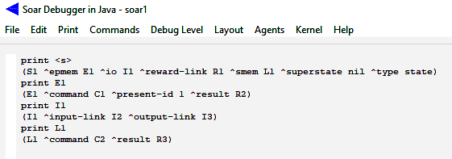
Tutorial – Problem Space Navigation
Working Memory Directed Graph: ^Edges and Nodes
1
C1
^present-id
^command
Nil
E1
^result
R2
^superstate
^epmem
^command
C2
^smem
L1
^result
R3
S1
^io
I1
^input-link
^reward-link
I2
^type
R1
^output-link
State
I3

Slide 31
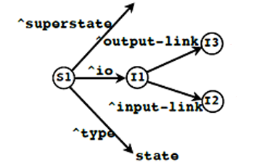
The Importance of Working Memory in Cognitive Systems.
Working Memory Concepts
States
State Identifier - (x)
Attribute - ^
Value - (x), "nil, blue"
Constants - "nil, blue"
Elements (WME's) - Triples (Identifier, attribute, value)
Objects - collection of working memory elements (State Object), 1st element in list is shared identifier.
Augmentations - WME's that make up an object
Variable - what a variable does – it matches any symbol in working memory with the only constraint being that all occurrences of the same variable in a rule match the same symbol. A variable can match an identifier, an attribute, or a value, depending on its position in a condition – if it is first in a condition it will match the identifier, second the attribute, and third the value. The first condition of every rule must start with the word “state”.
Operators - perform actions - they are the locus of decision making.
Decision Cycle - Operators (1) proposed, (2) selected, and then (3) applied.
Rules (Production) fire to propose and apply operators.
Preference (+, =)
Decision procedure selects current operator.
SOAR : Initial State
print <s>
(S1 ^epmem E1 ^io I1 ^reward-link R1 ^smem L1 ^superstate nil ^type state)

Slide 32
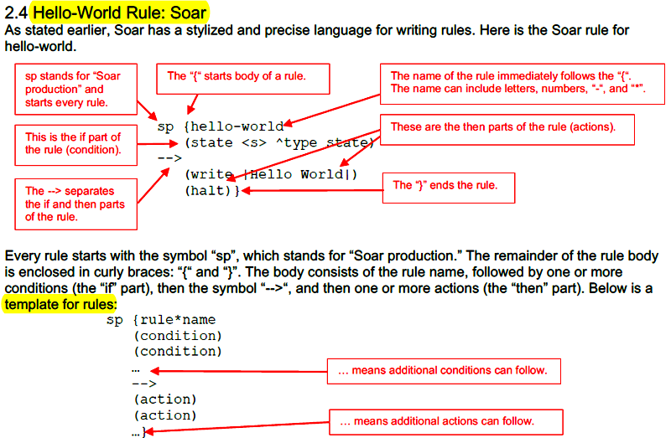
The SOAR Rule: HelloWorld.

Slide 33
BACK To WORK: Water Jugs - Reasoning Puzzle
Riddle / Problem to be solved.
Solution Steps - Optimal

Slide 34
Understand the Code: Water Jugs
SOAR : Initial State
print <s>
(S1 ^epmem E1 ^io I1 ^reward-link R1 ^smem L1 ^superstate nil ^type state)
SOAR : Debugger Trace
step
--- input phase ---
--- propose phase ---
Firing water-jug*propose*initialize-water-jug
(O1 ^name initialize-water-jug +)
(S1 ^operator O1 +)
=>WM: (15: S1 ^operator O1 +)
=>WM: (14: O1 ^name initialize-water-jug)
--- decision phase ---
=>WM: (16: S1 ^operator O1)
1: O: O1 (initialize-water-jug)
# PROPOSE - 'initialize-water-jug' Operator:
#
# Operator that initializes the water jug task - notice we use the 'water-jug' problem space
# This is a good practice to get into.
# If *no* task is selected '-^name', then propose the initialize-water-jug 'operator'.
sp {water-jug*propose*initialize-water-jug
(state <s> ^superstate nil
-^name)
-->
(<s> ^operator <o> +)
(<o> ^name initialize-water-jug)}

Slide 35
Understand the Code: Water Jugs
step
--- apply phase ---
--- Firing Productions (PE) For State At Depth 1 ---
Firing water-jug*apply*initialize-water-jug
Start: 1x5 Gallon Jug - Empty, 1x3 Gallon Jug - Empty
(J1 ^contents 0 + :O)
(J1 ^volume 5 + :O)
(I4 ^contents 0 + :O)
(I4 ^volume 3 + :O)
(S1 ^jug J1 + :O)
(S1 ^jug I4 + :O)
(S1 ^last-operator none + :O)
(S1 ^name water-jug + :O)
--- Change Working Memory (PE) ---
=>WM: (24: J1 ^contents 0)
=>WM: (23: J1 ^volume 5)
=>WM: (22: I4 ^contents 0)
=>WM: (21: I4 ^volume 3)
=>WM: (20: S1 ^jug I4)
=>WM: (19: S1 ^jug J1)
=>WM: (18: S1 ^last-operator none)
=>WM: (17: S1 ^name water-jug)
--- Firing Productions (IE) For State At Depth 1 ---
Firing water-jug*elaborate*empty
Firing water-jug*monitor*state
# APPLY - 'initialize-water-jug' Operator:
#
# If the initialize-water-jug operator is selected,
# then create an empty 5 gallon jug and an empty 3 gallon jug.
#
# Uncomment '^last-operator none' if you want to leverage ercording the last operator.
# *This greatly reduces the search for a solution.*
sp {water-jug*apply*initialize-water-jug
(state <s> ^operator.name initialize-water-jug)
-->
(<s> ^name water-jug
^last-operator none
^jug <i> <j>)
(<i> ^volume 3
^contents 0)
(<j> ^volume 5
^contents 0)
(write (crlf) | Start: 1x5 Gallon Jug - Empty, 1x3 Gallon Jug - Empty |)
}
print <s>
(S1 ^epmem E1 ^io I1 ^jug J1 ^jug I4 ^last-operator none ^name water-jug
^operator O2 ^operator O3 + ^operator O2 + ^reward-link R1 ^smem L1
^superstate nil ^type state)

Slide 36
SOAR: Important Concepts
Decision Procedure
Operator Preference
Persistence of WME’s – TMS
O-Support vs I-support
Math in SOAR
SOAR Decision Cycle
Operator Proposals
Operator Applications
State & Operator Monitoring
Desired State Recognition
Search Control
Problem Space

Slide 37
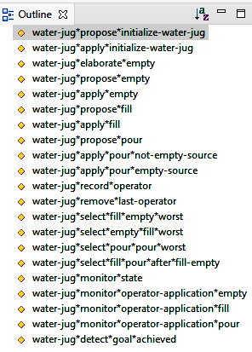
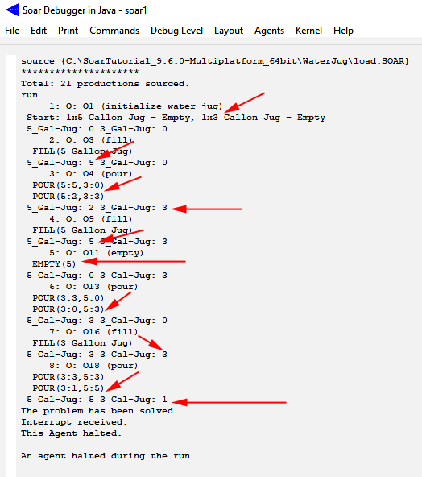
SOAR: Important Concepts

Slide 38
SOAR: Important Concepts
Persistence of Working Memory Elements
- SOAR's Truth Maintenance System (TMS)
1st Operator Proposal
3rd Operator Removed
Automatically
Working Memory
sp {water-jug*propose*initialize-water-jug
(state <s> ^superstate nil
-^name)
-->
(<s> ^operator <o> +)
(<o> ^name initialize-water-jug)}
In a Nutshell
WME's created by ‘Operator Application Rules’ persist because they change the agents state in the problem space.
WME's created by ‘other’ rules get redacted when their rules no longer match the current state.
Conditions of Proposal Rule
no longer match.
Does not modify
The current state.
Structure
Initialize
WME
4th
Proposal Rule Retracts
WME
Attribute 2
Problem Space
Operator
Structure
2nd Operator Apply
WME
Structure
Attribute 1
WME
sp {water-jug*apply*initialize-water-jug
(state <s> ^operator.name initialize-water-jug)
-->
(<s> ^name water-jug
^last-operator none
^jug <i> <j>)
(<i> ^volume 3
^contents 0)
(<j> ^volume 5
^contents 0)
(write (crlf) | Start: 1x5 Gallon Jug - Empty, 1x3 Gallon Jug - Empty |)}
“Modifies Agents State”
Attribute N
Conditions of Apply Rule
no longer match.
These ‘other’ working memory elements are said to have i-support – meaning they will persist only as long as the rule instantiation that created them still matches.
5th
7th
Working Memory
Elements Remain.
6th
Apply Rule Retracts
“O-Support”
WME’s

Slide 39
Tutorial - Interacting with an Environment
Example to learn SOAR Environmental Interactions.

Slide 40
SOAR: Important Concepts

Slide 41
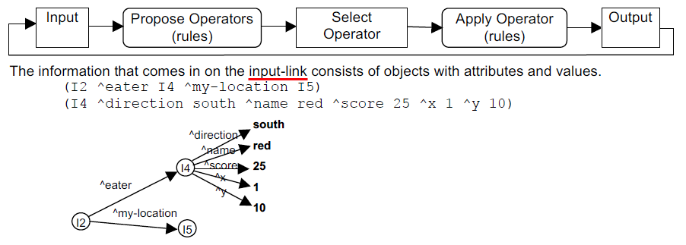
SOAR: Important Concepts

Slide 42
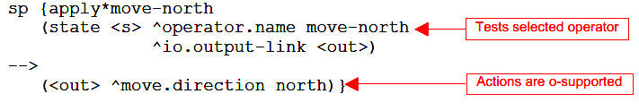
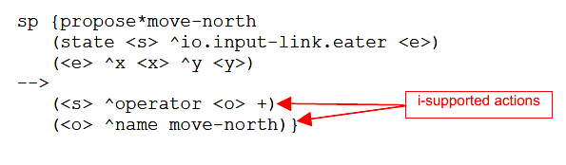
SOAR: Important Concepts
XXXXXXXXXXX
Operator Application: Persistence
In Soar, all working memory elements created by an operator application rule are persistent. A rule is an operator application rule if it tests a selected operator and modifies the state. Persistent working memory elements are said to be operator-supported, or o-supported, because they are created by operators.

Slide 43
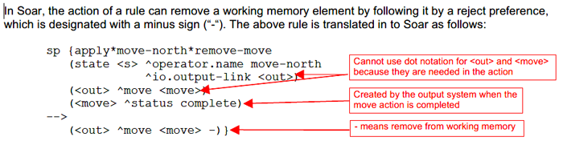
SOAR: Important Concepts
During the propose phase, only rules that have i-supported actions will fire. During the apply phase, both o-supported and i-supported rules fire.

Slide 44
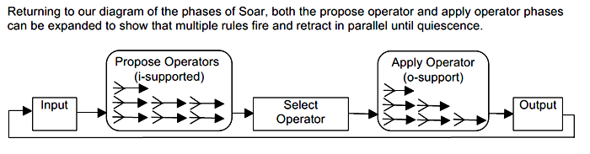
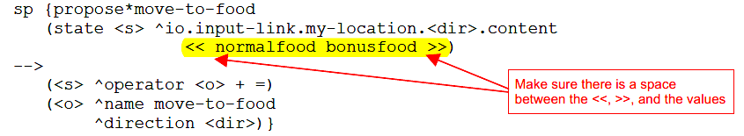
SOAR: Important Concepts

Slide 45
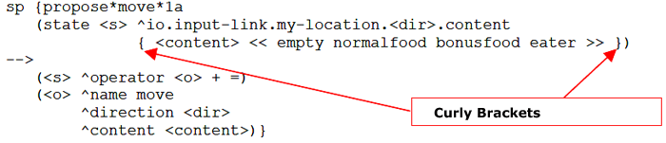
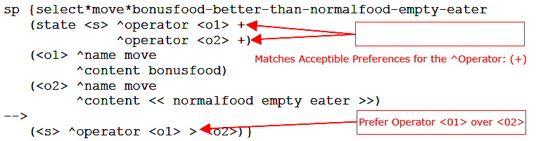
SOAR: Important Concepts

Slide 46
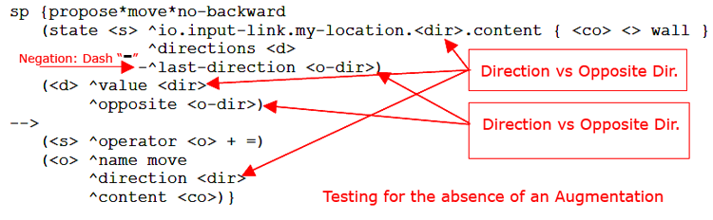
SOAR: Important Concepts

Slide 47
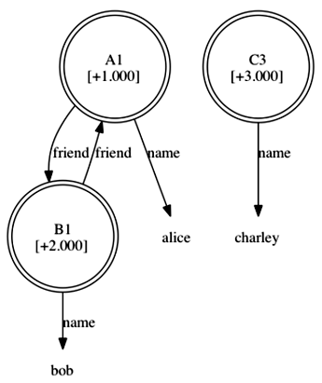
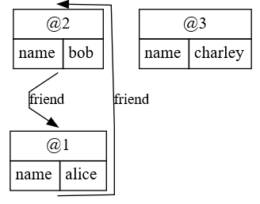
SOAR: Important Concepts

Slide 48
Tutorial – Semantic Memory
Example to learn SOAR Semantic Memory.

Slide 49
Tutorial – Problem Space and SubGoals
Metacognition involves “stepping back” and have a separate state from which to reason (without disrupting original reasoning)
Whenever an impasse arises, SPAR automatically creates a new (sub)state.
The purpose of this state is to provide a context for selecting and applying operators to resolve the impasse.
An impasse arises if there is insufficient/conflicting procedural knowledge to select an operator
• when no operator is proposed.
– [state no‐change]
• when multiple operators are proposed by insufficient preferences to select between them?
– [operator tie]
• when an operator is selected, but it can’t be applied by a single rule?
– [operator no‐change]
• when multiple operators are proposed, but the preferences conflict.
– [operator conflict]
Once a substate is created, operators can be selected and applied just as they are in the original state. These operators can change the local state, but they can also change the contents of original state (S1) by modifying the original state directly or indirectly. An impasse can also arise in the substate, which then leads to a stack of states.

Slide 50
Tutorial – Problem Space and SubGoals
Operator no-change impasses are resolved when the current operator is no longer preferred in the original state (S1 in the trace above). That can be because either the proposal for the current operator is retracted (the rule creating the proposal no longer matches), or because of the set of operator preferences changes so that another operator is preferred.
State no-change impasses are resolved when an operator has been proposed (with an acceptable preference), so that there is at least one candidate operator.
Tie and Conflict impasses are resolved when sufficient preferences have been created so that the decision procedure can select an operator.
The processing in a substate can lead to the creation of structures that are part of the original state (the
superstate). These are called results.
All of the states in working memory are “active” in that rules can fire for any level – it is not the case that processing in the top state comes to a halt while the processing goes on in the substate.
In fact, it is the ability of the processing in the original state to start up that often resolves the impasse and leads to the termination of the subgoal.
When the impasse is resolved, the substate is automatically removed from working memory – it has
served its purpose and is no longer needed. However, all of the results that were created in the subgoal can still persist. This is important because the results are changes to the superstate and are usually responsible for eliminating the impasse.

Slide 51
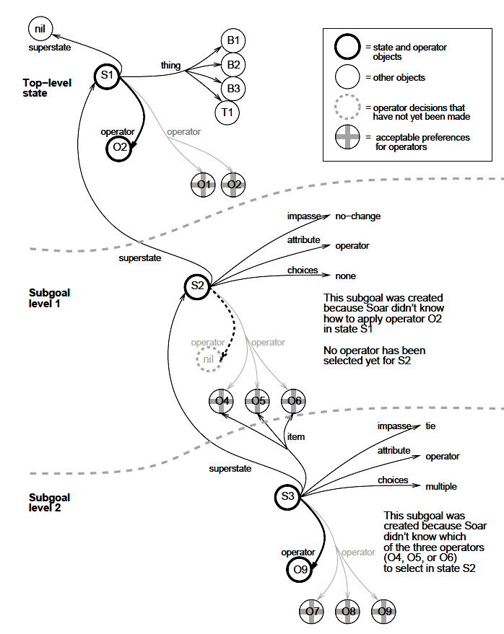
Tutorial – Problem Space and SubGoals
Some results receive i-support, while others receive o-support.
The type of support received by a result is determined by the function it plays in the superstate, and not the function it played in the state in which it was created.
RESULTS:
In order to resolve impasses, subgoals must generate results that allow the problem solving at higher levels to proceed. The results of a subgoal are the working memory elements and preferences that were created in the substate, and that are also linked directly or indirectly to a superstate (any superstate in the stack).
Linked:
These working memory elements and preferences will not be removed when the impasse is resolved because they are still linked to a superstate, and therefore, they are called the results of the subgoal.
A result has either i-support or o-support; the determination of support is described in the graph.
Whenever a substate is removed, all working memory elements and preferences that were
created in the substate that are not results are removed from working memory.
An impasse is resolved when processing in a subgoal creates results that lead to the selection of a new operator for the state where the impasse arose.

Slide 52
Tutorial – Problem Space and SubGoals
Here are possible approaches for resolving specific types of impasses are listed below:
Tie impasse | A tie impasse can be resolved by productions that create preferences that
prefer one option (better, best, require), eliminate alternatives (worse, worst,
reject, prohibit), or make all of the objects indifferent (indifferent).
Conflict impasse | A conflict impasse can be resolved by productions that create preferences
to require one option (require), or eliminate the alternatives (reject, prohibit).
Constraint-failure impasse | A constraint-failure impasse cannot be resolved by additional
preferences, but may be prevented by changing productions so that they create
fewer require or prohibit preferences. A substate can resolve a constraint-failure
impasse through actions that cause all but one of the conflicting preferences to retract.
State no-change impasse | A state no-change impasse can be resolved by productions
that create acceptable or require preferences for operators.
Operator no-change impasse | An operator no-change impasse can be resolved by productions that apply the operator, change the state so the operator proposal no longer
matches, or cause other operators to be proposed and preferred.
Decision Cycles & Substates:
The main change when there are multiple substates is that at each phase of the decision cycle, Soar goes through the substates, from oldest (highest) to newest (lowest), completing any necessary processing at that level for that phase before doing any processing in the next substate.
Thus, whenever a level in the state stack is reached, all production activity is guaranteed to be consistent with any processing that has occurred at higher levels.

Slide 53
Tutorial – Problem Space Navigation
Example to learn SOAR Problem Spaces.

Slide 54
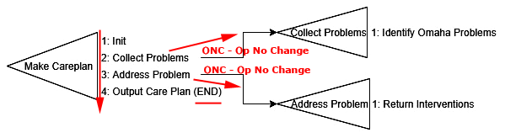
Tutorial – Problem Space Navigation
POC Problem Space Design
Order of Processing
Initialize Problem Space
Collect Problems
SubSpace: Identify Omaha Problems
Address Problem
SubSpace: Return Interventions
Output Care Plan
“ONC” is the Vehicle for creating substates.
Proposals w/out a corresponding APPLY.
Impasse Resolution Vehicle:
The return of the ^problem-data structure from the Substate.

Slide 55
Tutorial – Problem Space Navigation
POC Problem Space Example
TS: make-careplan
SS: collect-problems
O: collect-problems
Re: -^problem-data
Misc WMEs
Create SS =>
<= Return from SS
AP: identify-omaha-problems
R: +^problem-data
O: address-problems
Re: -^intervention-portfolio
SS: address-problems
Create SS =>
<= Return from SS
AP: return-interventions
R: +^intervention-portfolio

Slide 56
Tutorial – Problem Space Navigation
Working Memory Directed Graph: ^Edges and Nodes
1
C1
^present-id
^command
Nil
E1
^result
R2
^superstate
^epmem
^command
C2
^smem
L1
^result
R3
S1
^io
I1
^input-link
^reward-link
I2
^type
R1
^output-link
State
I3

Slide 57
Tutorial – Problem Space Navigation
^superstate
State

Slide 58
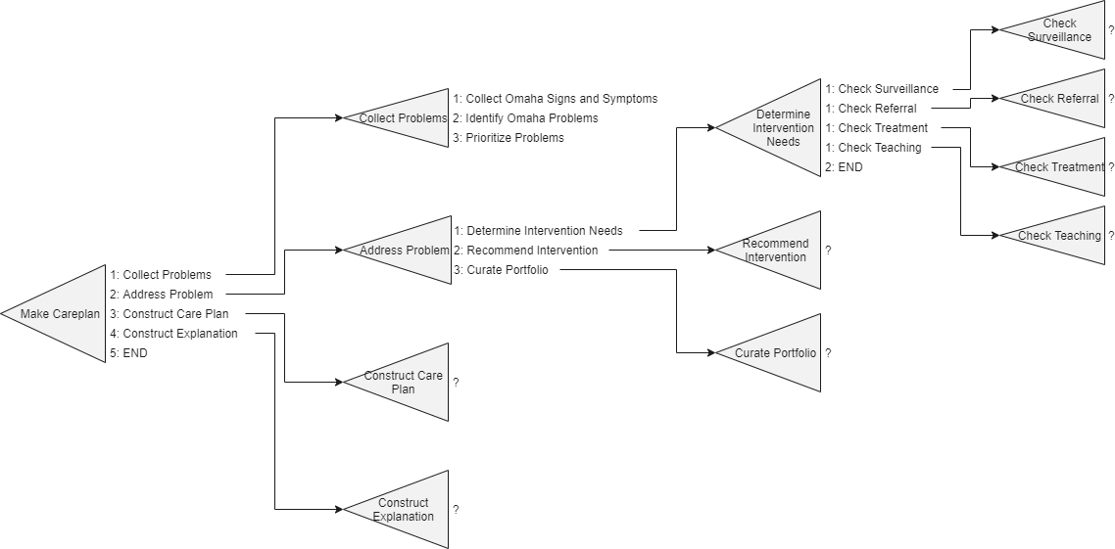
SOAR: Important Concepts

Slide 59
SOAR: Important Concepts
XXXXXXXXXXX

